Slide 1

Application of Data Science in Different Industries
*Leveraging Data to Drive Innovation Across Industries*
Master Emeka Iheoma
Data Scientist
Gomycode
August 23, 2024

Slide 2
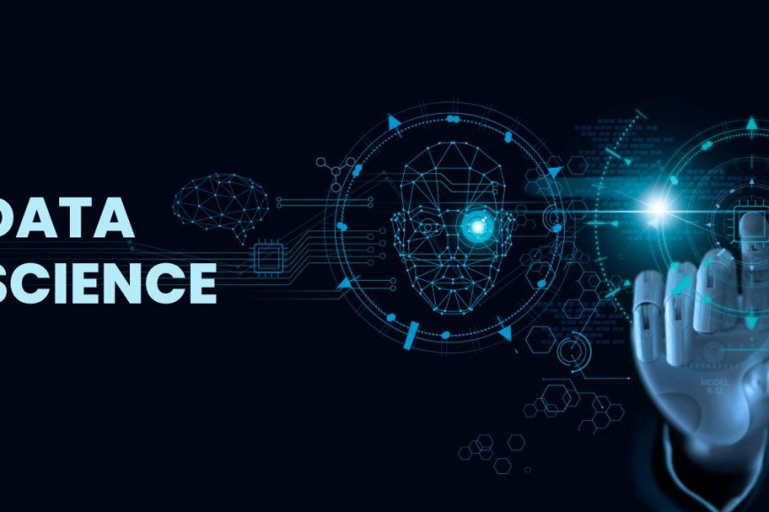
Introduction to data science
What is data science?
Definition: Data Science is an interdisciplinary field focused on extracting knowledge and insights from data.
Core Components: Statistics, Machine Learning, Data Analysis, and Big Data.
Importance: Drives decision-making, innovation, and optimization across various sectors.
This Photo by Unknown Author is licensed under CC BY-SA

Slide 3
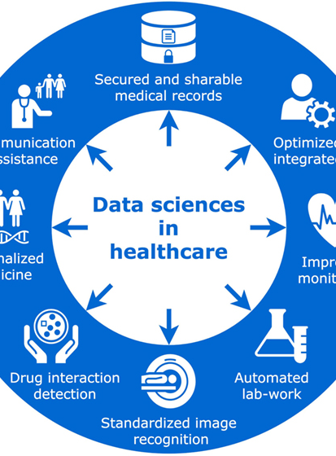
Data science in Healthcare
Overview
Revolutionizing patient care and medical research.
Improving diagnosis, treatment, and operational efficiency. Case
Study 1: Predictive Analytics in Patient Care
Example: Predicting patient readmission rates.
Impact: Improved patient outcomes and reduced healthcare costs.
Case Study 2: Personalized Medicine
Example: Using genomics data to tailor cancer treatment.
Impact: Enhanced treatment effectiveness and patient survival rates.
This Photo by Unknown Author is licensed under CC BY

Slide 4
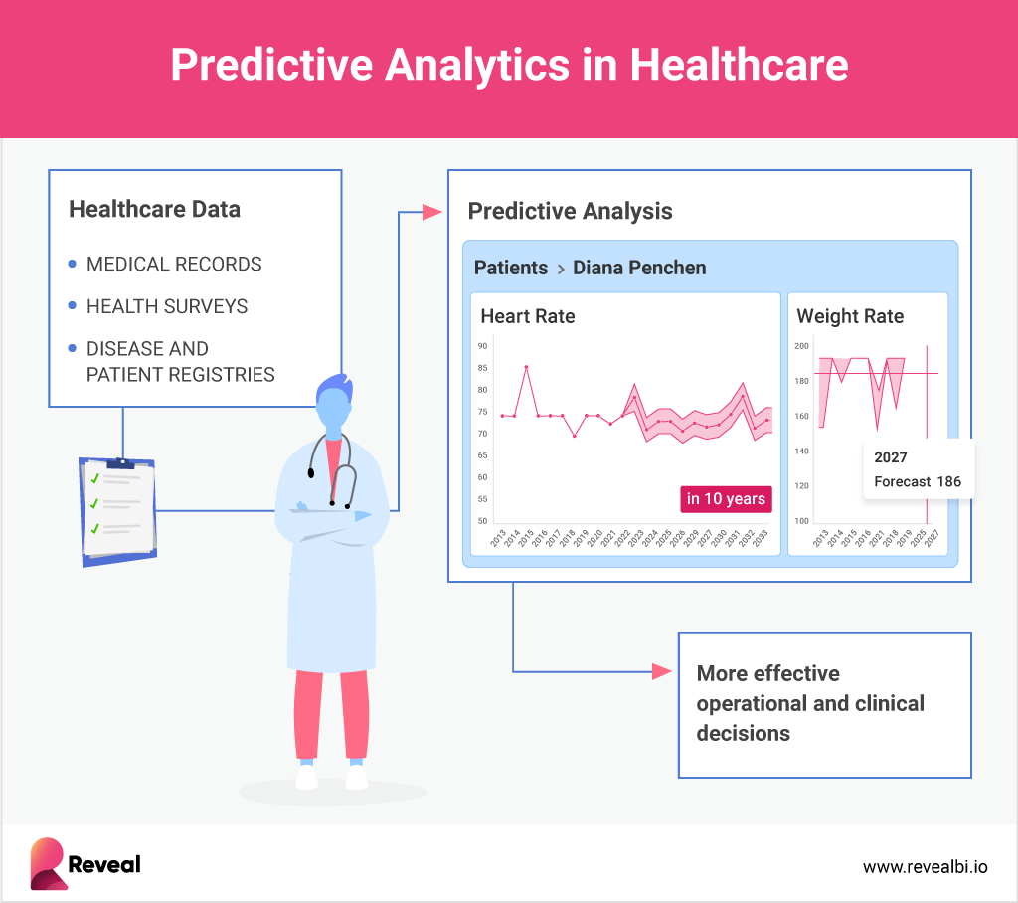
Data Science in Healthcare (Visualization)

Slide 5

Data science in Finance
Overview
Enhancing risk management, fraud detection and investment strategies.
Study 1: Fraud Detection
Example: Anomaly detection using machine learning.
Impact: Reduced financial losses and improved security.
Case Study 2: Algorithmic Trading
Example: Using AI to automatic trading decisions.
Impact: Increased trading efficiency and profitability.

Slide 6
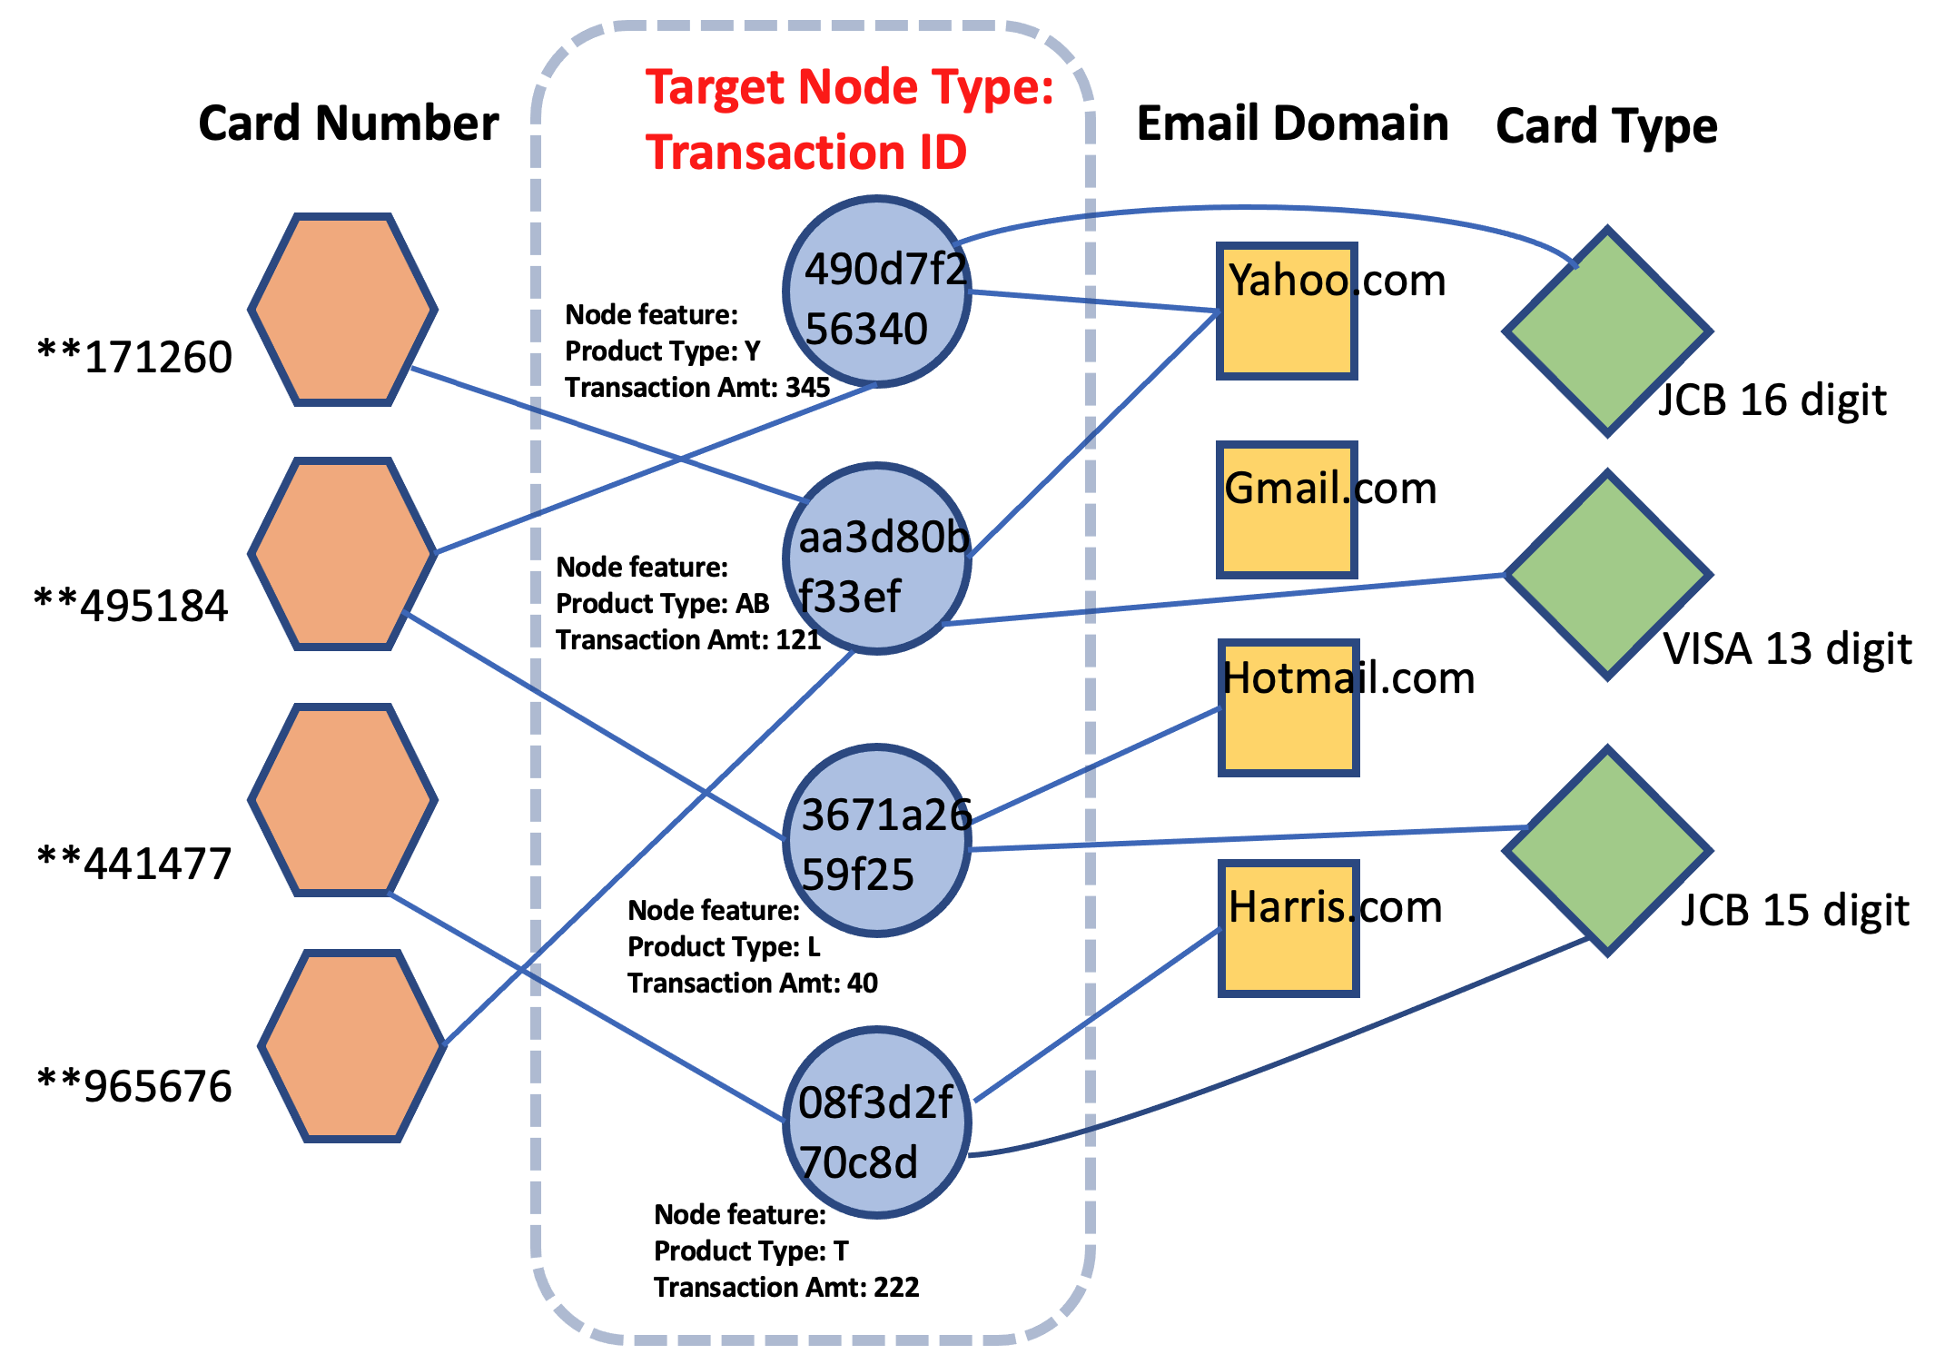
Data Science in Finance (Visualization)

Slide 7
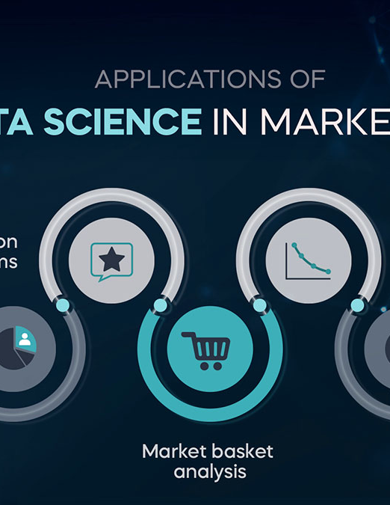
Data science in Marketing
Overview
Driving Customer insights, personalization, and campaign optimization.
Study 1: Customer Segmentation
Example: Clustering customers based on purchasing behavior.
Impact: Targeted marketing and increased ROI.
Case Study 2: Predictive Marketing
Example: Predicting customer churn and taking preemptive actions.
Impact: Improved customer retention and satisfaction.

Slide 8
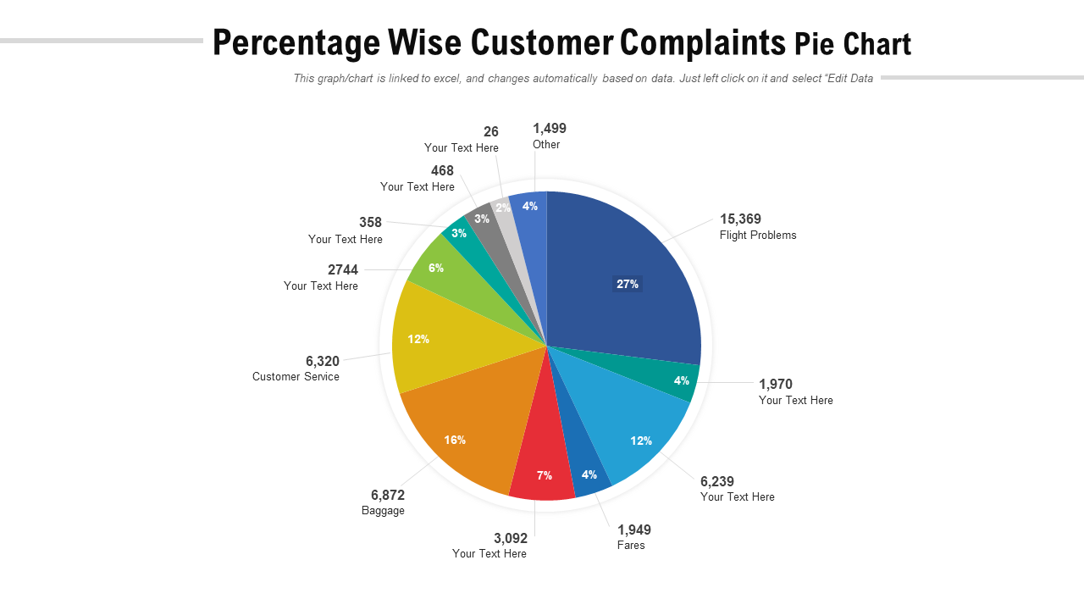
Data Science in Marketing (Visualization)

Slide 9
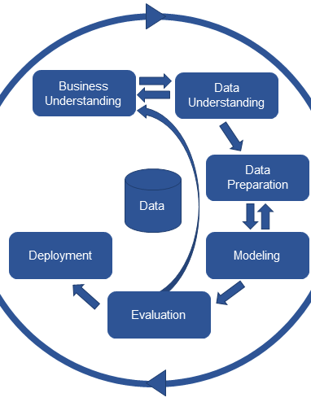
Cross-Industry Benefits of data science
Common Advantages Across Industries:
Improved decision-making and efficiency.
Enhanced customer experience.
Competitive advantage through innovation.
Cost reduction and revenue optimization.
This Photo by Unknown Author is licensed under CC BY-SA

Slide 10
Conclusion and Future trends
Summary:
- Data Science is transforming industries, leading to innovative solutions and enhanced outcomes.
Future Trends:
Growing use of AI and machine learning.
Increased focus on ethical data usage and privacy.
Expansion of data-driven strategies across all sectors.
Call to Action:
Stay informed and leverage data science for continued growth and success in your field.
Questions?

